Slide 1
Project Synopsis Presentation
Title: E-Ledger tracking for Students
Presented By
Mr. ANIRUDH UDAY PARVATIKAR USN: 1BY22MC007
Ms. KEERTHANA N USN: 1BY22MC023
Under the guidance of:
Nirupama. B. K
Assistant Professor

Slide 2
Content
Introduction
Literature Survey context
Objectives
Proposed System
Modules Identified
Hardware and Software Requirements

Slide 3
Introduction
Student life is one the main phase in everyone’s life where people tend to learn and get to experience many things before actually start to lead their life.
Students usually are supported by their parents/guardians in the subject of using money.
Parents usually give their ward small amount of money maybe monthly/weekly basis & we call it as pocket money.
Students make use of this money maybe for hanging out with their friends, buying materials required for school/college purposes.
As students may not have notable experience in handling and tracking money expenditures, it becomes difficult for them to manage their expenses, and to really know how much they are spending on what things.

Slide 4
Introduction-contd
E-Ledger aims to eliminate this problem by offering solution for the students effectively for free by providing tool where one can feed their day-to-day expenses and the tool shows total amount that has been spent in any given time period.

Slide 5
Literature Survey
Sl.no | Name & Year | Author | Techniques used | Conclusion | Gaps Identified
1 | Expense Tracker application using Naïve Bayes (2023) | Raj Thakare, Ninad Thakare, et.al | Naïve Bayes algorithm is used to classify messages to count as expenditure and track them without human intervention | Application successfully now can differentiate between user SMS and Bank transactional SMS and automatically track expenses. | Users do not have option to self-host database and have to rely on app designer for database
2 | Expense Tracker: SNIT Kerala(2023) | Subi James, Prof. Rajitha P. R | 2 Tier architecture implemented to address the storage and interface problem and designed solution | Created android application so that the service can be accessible from mobile devices and target more customers | Other expense management services lacked the service of authentication, this intends to address the issue.

Slide 6
Literature Survey-CONTD
3 | Budget Planner Tool Assessment Report(2022) | Ashley Wong, Jai Singh, et.al | Performed in detailed analysis of the market and to achieve this they created team to go on ground and implemented solution | After certain age human beings tend to neglect budgeting, which causes over the head expenses. | Need to educate people more about managing money.
4 | Expense Tracker(2021) | Aman Garg, Mukul Goel, Sagar Mittal | Developed desktop solution to track expenditures | Application which aims to show people about their expenses | Have feature to summarize overall expenditure.
5 | Expense Tracker: A Smart Approach to track | Hrithik Gupta, et.al | Java & MySQL used to develop Application | Aims to reduce confusion & frustration from | Still lacks the feature to provide persistent backup

Slide 7
Objectives
Improve financial literacy: Help students understand their spending habits, track credits and debits & develop budgeting skills.
Promote responsible financial decision-making: Encourage students to set financial goals, prioritize needs over wants, and avoid unnecessary debt.
Increase financial independence: Empower students to manager their finances independently and prepare for future financial responsibilities.
Reduce stress and anxiety about finances: Provide a clear and organized system for tracking finances, which can alleviate stress and anxiety associated with money management.
Boost academic performance: Improve time management and study habits by integrating academic progress tracking with financial records.

Slide 8
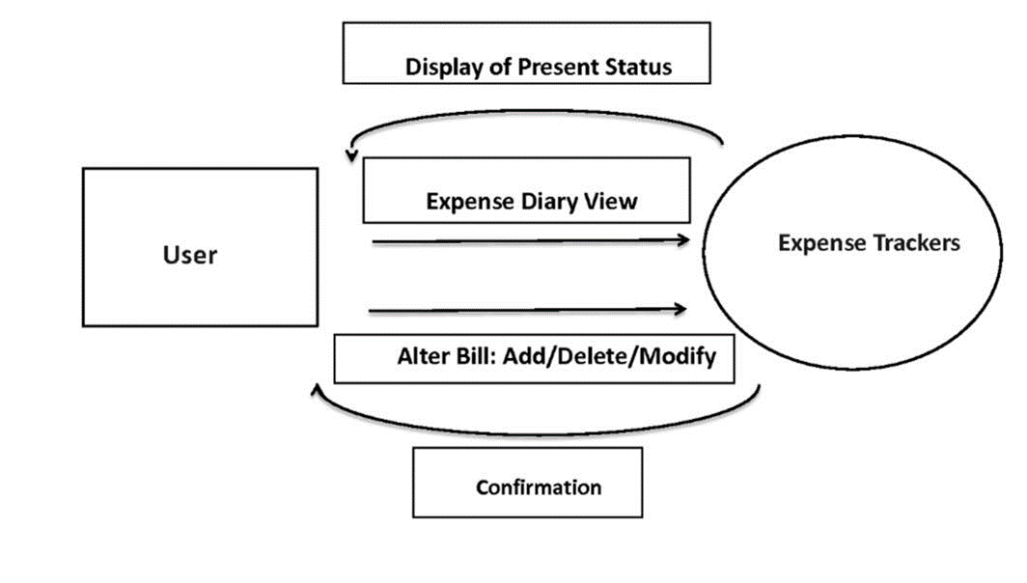
Proposed system

Slide 9
Modules identified
In this project of creating a web based platform for enabling student to track their expenses, there are several modules that we have identified, some of them are:
Creation of attractive landing page:
Whenever we are creating web based service, we have to make sure that we make the landing page i.e first page user is showed when he/she visits our site is as much attractive and intuitive as possible.
It should make them organically sign-up to our services and start using them.
Selecting database for efficient storage:
We need storage solution for saving all the expenditure of the students, and one
of the storage solutions we have identified for this project is using google
firebase database.
b. This is NoSQL type of database which does not have fixed schema, this is helpful
in this scenario as every student has different expenditure.

Slide 10
Modules identified-CONTD
3. Account Creation:
In this stage we work on how exactly we enable our users to create account to use our services.
Google cloud platform allows us to use “Sign-in with Google” feature, this will significantly enable us to onboard many users in short period of time.
4. Deployment:
We can purchase attractive, easy to remember domain where we can host this site.
5. Maintenance:
Initial setup cost can be managed.
We can always ask students to pledge, contribute how much ever they can to keep the service going on.
The webpage can be even hosted by students themselves, hence not needing to use our platform all the time.

Slide 11
Hardware and software Requirements
Hardware requirements
CPU: Intel i3 3rd gen and above, AMD Ryzen 2 and above.
RAM: 4GB and above.
Storage: 150GB minimum.
Software requirements
Visual Studio Code
Chrome Browser
NodeJS
Google Cloud Platform account

Slide 12
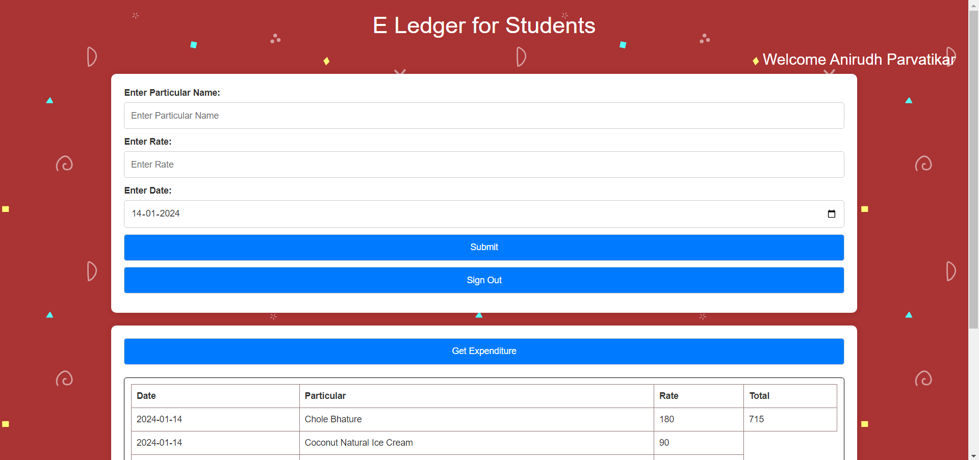
Sample Outputs

Slide 13
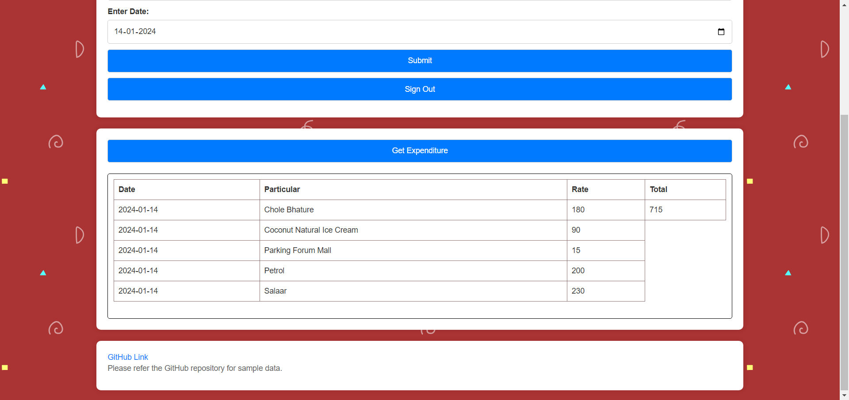

Slide 14
Thank you!

